Slide 1
CS5344 Project, Possible Application #1 by Archit Agarwal, Jiang Kan (A0134498), Lim Boon Kiat (Marcus)
Implement following AR discovery algorithms
Apriori Algorithm (optionally using Triangular Matrix)
PCY (optionally with multihash)
Random Sampling
Use webpages as items (eg. 25,000 pages), id is integer.
Use {page, key words} relation as baskets (eg. 5000 baskets).
Basket 1 = all webpages relates to key words {tennis, Djokovic, Federer}, written as {1, 5, 200, 376, 26654}
Basket 2 = all webpages relates to key words {Djokovic, “Australia Open”, Murray, Ace}, written as {1, 5, 200, 3882}
Discover associated webpages. Measure I/O, memory, false positive/negative of the implemented algorithms.
Assume test machine has only 1G RAM.
Naïve scheme requires 2*(25,000)² = 1.25G
5000 baskets (assume avg basket size = 20 Bytes) is small. They can be fit into memory easily and leave sufficient memory to do counting. Need to artificially generate 5,000,000 larger baskets to test the Random Sampling algorithm.
This page is what we submitted previously. Mid-term update is at page 2.

Slide 2
Mid-term Update
Ways to measure false positive/negative:
We thought of using the following method to measure false positive/negative:
Purposely inject 10 identical items. Set appropriate min_support (eg. 500, ie. 10% of 5000 baskets). Ideally, there is only ONE frequent itemset associated with any of the 10 items.
False positive = (# of frequent itemsets associated with any of the 10 items) – 1
False positive/negative may also happen when Random Sampling algorithm is used to load baskets.
None of these is interesting because they don’t really help us to improve our algorithm.
At this point of time, we have implemented (in Java) all the algorithms listed in page 1. We are now focusing on the performance test. With the test result, we hope to improve our algorithms.
Some of our observations:
One of our test data set has 3569 baskets, ~120 items, many items are closed associated. The largest associated itemset is {901, 902, 903, 904, 905, 906, 907} with support count = 1552.
Our Triangular Matrix algorithm used ~900MB RAM.
Our Apriori algorithm used slightly more than 900MB RAM.
Our PCY algorithm used 1000MB RAM.
We are surprised to see so much RAM is used in this small dataset. It could be our implementation issue. We are checking it out.

Slide 3
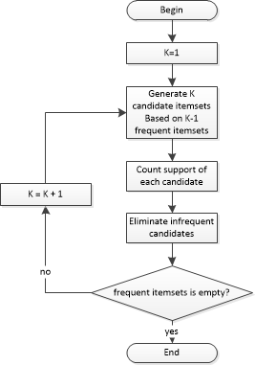
Apriori Algorithm Flowchart

Slide 4
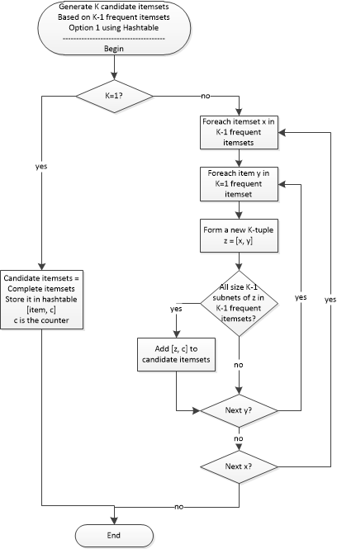
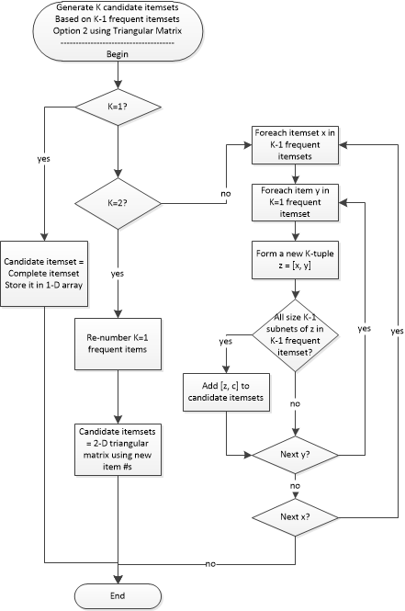

Slide 5
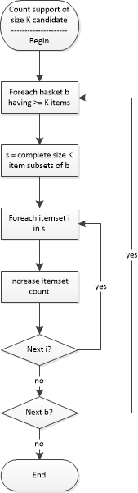
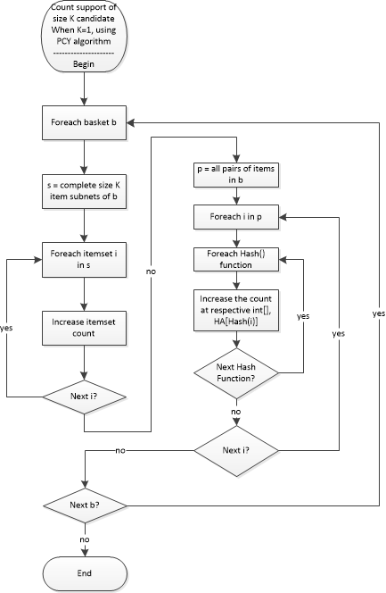

Slide 6
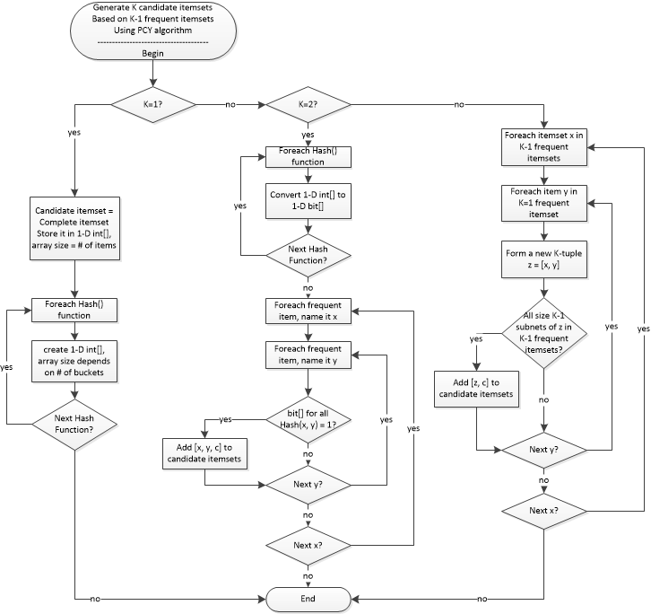

Slide 7
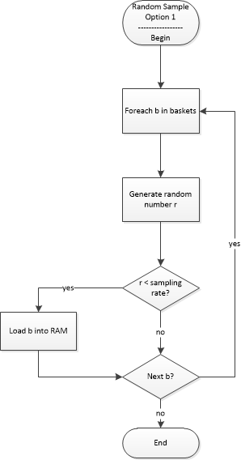
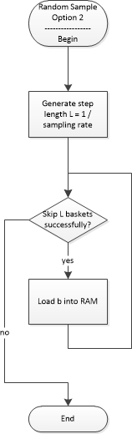

Slide 8
How the data was collected?
Apache Nutch
Define seeds (several urls)
Define url pattern (eg. +^http://www.atpworldtour.com/)
Crawl N rounds (eg. crawl urls crawl_dir N)
Dump all the crawled html files (eg. nutch dump -mimetype text/html -outputDir dump2 -segment crawl2/segments -flatdir)
Apache Lucene
Analyzer (remove stop word, stemming)
Given different terms, find all files containing the terms, this is one basket
Output the file ids, One line per basket
Sample basket file

